Slide 1
Computer Operating System Concepts

Slide 2
Computer System Structure
Chapter Two

Slide 3
Table of Content
Computer System Operation
I/O Structure
Storage Structure
Hardware Protection

Slide 4
Computer System Operation

Slide 5
Computer System Operation
Computer system consists of a CPU and a number of device controllers that are connected through a common bus that provides access to shared memory
CPU and device controllers execute concurrently.
Memory controller synchronizes access to memory.

Slide 6
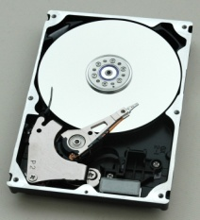
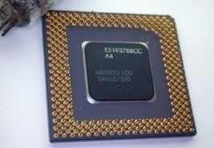
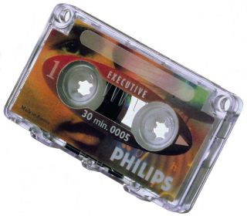
Computer System Operation Cont’d
CPU
Hard Disk
Controller
Printer
Controller
Tape Drive
Controller
Memory
Controller
M e m o r y
Notes:
CPU and controllers execute concurrently, competing for memory cycles.

Slide 7
Computer System Operation Cont’d
Each device controller is in charge of a particular device type.
Each device controller has a local buffer
CPU moves data from/to main memory to/from local buffers
Device controller informs CPU that it has finished its operation by causing an interrupt.

Slide 8
Interrupts
A signal sent to the CPU
Interrupt transfers control to the interrupt service routine generally, through the interrupt vector, which contains the addresses of all the service routines.
Interrupts:
Hardware Interrupts
Software Interrupts: system calls

Slide 9
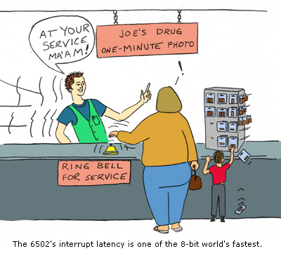
Interrupts Cont’d
A trap is a software generated interrupt caused by:
Error: division by zero or invalid memory access
Request: from a user program to O/S
An operating system is interrupt driven.

Slide 10
Interrupt Handling
CPU is interrupted
CPU stops current process
CPU transfers execution to a fixed location
CPU executes interrupt service routine
CPU resumes process
Notes:
Interrupts must be handled quickly
Interrupted process information must be stored

Slide 11
Interrupt Handling Mechanisms
Generic
Examine interrupt information and calls Specific routine
Interrupt vector
Table of pointers to interrupt routines for various devices
Applied in Unix & DOS

Slide 12

Computer System Startup
Power up
Initial program: bootstrap
Stored in ROM
Initialize:
CPU registers
Device controllers
Memory contents
Load the operating system (kernel)
Kernel starts the first process, init
Init waits for an event (interrupt) to occur

Slide 13
I/O Structure

Slide 14
I/O Structure
Controllers:
Is in charge of a specific type of device
Moves data between device and local buffer
A controller may have more than one device
Buffer size varies

Slide 15
Two I/O Methods
Synchronous I/O:
Process request I/O operation
I/O operation is started
I/O Operation is complete
Control is returned to the user process
Asynchronous I/O:
Process Request I/O operation
I/O operation is started
Control is returned immediately to the user process
I/O continues while system operations occur

Slide 16
Device Status Table
The operating system uses a table containing an entry for each I/O device
Each table entry indicates the device's type, address, and state (not functioning, idle, or busy)
If the device is busy with a request, the type of request and other parameters will be stored in the table entry for that process
The operating system will also maintain a wait queue-a list of waiting requests-for each I/O device.

Slide 17
Direct Memory Access Structure
Used for high-speed I/O devices able to transmit information at close to memory speeds.
Device controller transfers blocks of data from buffer storage directly to main memory without CPU intervention.
Only one interrupt is generated per block, rather than the one interrupt per byte.

Slide 18
Storage Structure

Slide 19
Storage Structure
Main memory
Only large storage media that the CPU can access directly.
Secondary storage
Extension of main memory that provides large nonvolatile storage capacity.

Slide 20
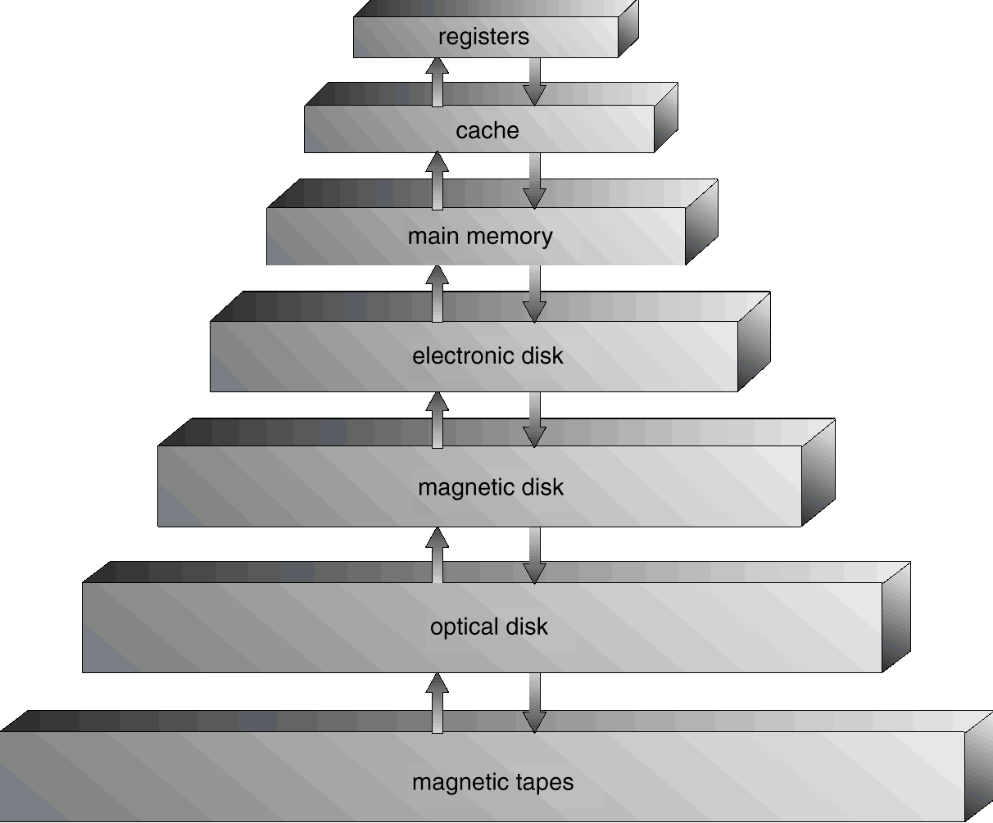
Storage-Device Hierarchy

Slide 21
Difference of Storage Devices
Speed
Cost
Capacity
Volatility
Reliability
Portability

Slide 22
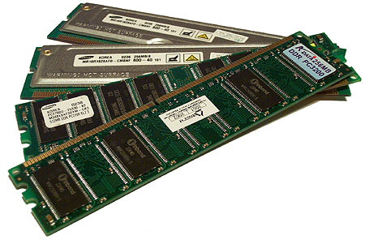
RAM
Array of memory words
Each byte has an address
Memory Address:
Physical
Logical
CPU Instructions:
Load: moves a word from main memory to CPU register
Store: move a word from CPU register to main memory

Slide 23
Magnetic Disk
Rigid metal or glass platters covered with magnetic recording material
Disk surface is logically divided into tracks, which are subdivided into sectors.
The disk controller determines the logical interaction between the device and the computer.
Notes:
EIDE
ATA
SCSI
SATA

Slide 24
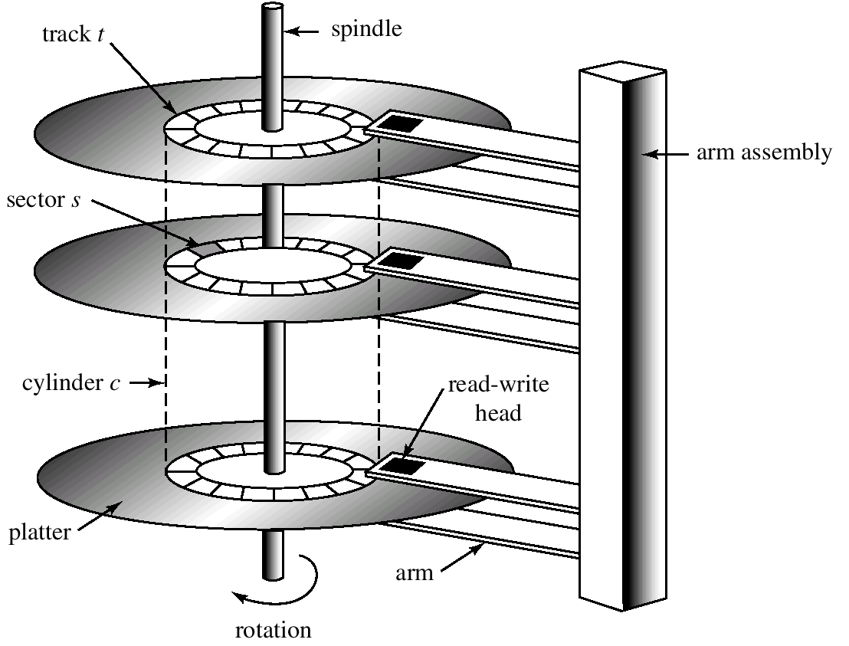
Magnetic Disk Cont’d

Slide 25
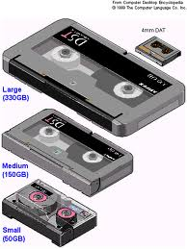
Magnetic Tapes
Early secondary storage
Slow access time
Usage
Backup
Storage of infrequently used information

Slide 26
Hardware Protection

Slide 27

Hardware Protection
Early OS:
Single user
Programmer had full control of hardware
Programmer was responsible of I/O
Error in a program
Single task
Only one program affected
Multi task
Could cause problems to other programs
Desktop OS allow a program to access any part of memory or affect other programs instructions or data

Slide 28
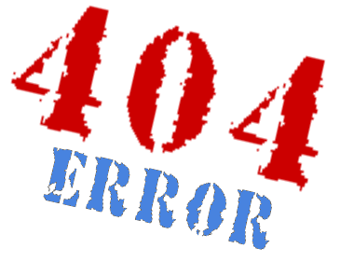
Error Handling
Errors
Illegal instruction
Infinite loop
Access of other memory addresses
Handling Errors
Errors are detected by hardware
Hardware trap the error to the O/S
Errors are handled by the O/S
O/S terminates process
O/S dumps the process to disk (if needed)

Slide 29
Ensuring OS Proper Operation
I/O Protection: illegal instructions
Memory protection: illegal memory access
Base & limit registers
CPU Protection: infinite loops
Timers

Slide 30
Hardware Dual-Mode
Monitor Mode
Execution done on behalf of operating system.
User Mode
Execution done on behalf of a user.
Mode bit added to computer hardware to indicate the current mode
0 → Monitor mode
1 → User mode

Slide 31
Dual Mode Operation
At boot time: Monitor mode
OS start user processes: User mode
Interrupt / Trap: Monitor mode
OS always in monitor mode
User program always in user mode

Slide 32
Privileged Instructions
Machine instructions that may cause harm
It can be executed only in monitor mode
It can not be executed in user mode: trapped
A user process request the OS to execute a privileged instruction: System call

Slide 33
1. I/O Protection
All I/O instructions are privileged
I/O device registers are inaccessible by user
Users can not issue I/O instructions directly
Users must do it through the OS
*Note: Users can never have control of the computer in monitor mode

Slide 34
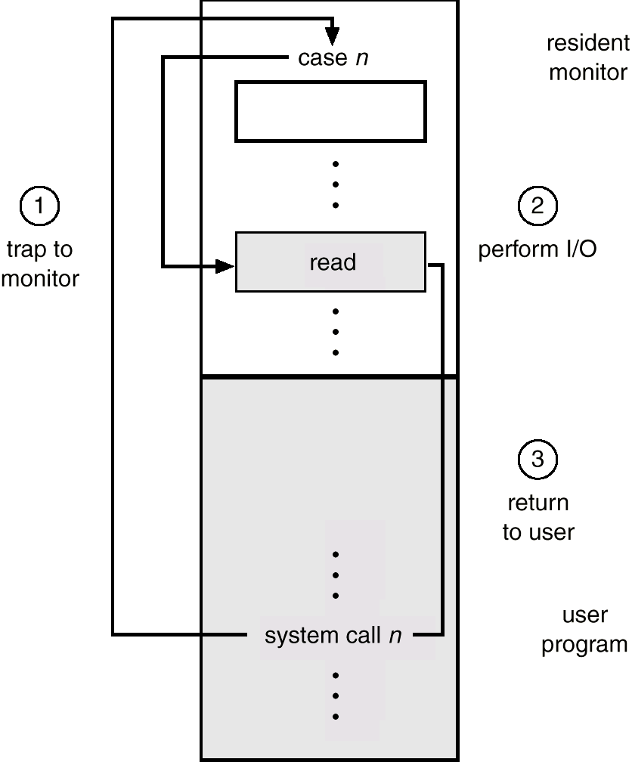
System Calls Execution
User System call
Trap to monitor
Perform I/O
Return to user

Slide 35
2. Memory Protection
Must provide memory protection at least for the interrupt vector and the interrupt service routines.
In order to have memory protection, add two registers that determine the range of legal addresses a program may access:
Base Register
Holds the smallest legal physical memory address.
Limit Register
Contains the size of the range
Memory outside the defined range is protected.

Slide 36
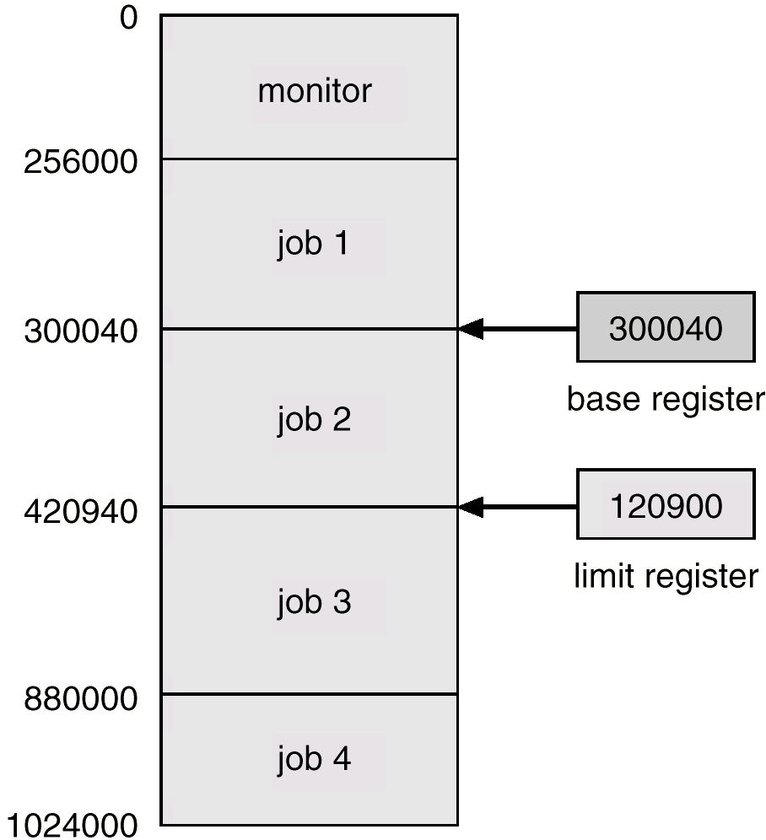
Use of Base and Limit Registers

Slide 37
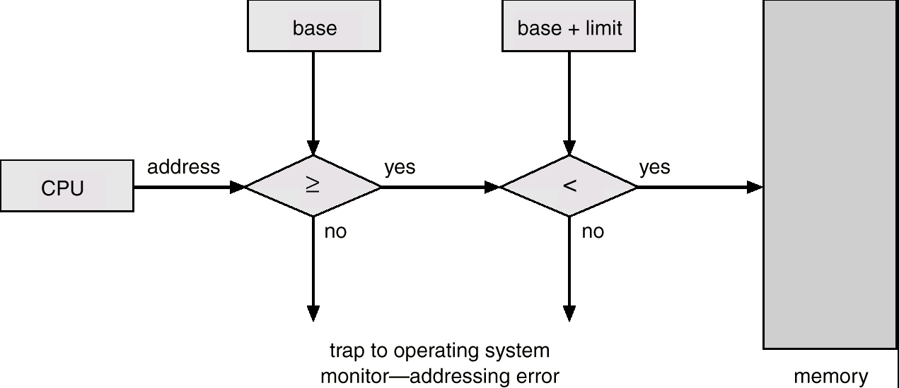
Hardware Address Protection

Slide 38

3. CPU Protection
Timers
interrupts CPU after specified period
Timer is decremented every clock tick
Use of timers
Time sharing systems
Interrupt every N milliseconds
Switch control to other processes
Computing current time

